Slide 1


Introduction to AngularJS
December 2014
This document is confidential and contains proprietary information, including trade secrets of CitiusTech. Neither the document nor any of the information contained in it may be reproduced or disclosed to any unauthorized person under any circumstances without the express written permission of CitiusTech.

Slide 2
Agenda
History
Single Page Application
Key Challenges Before AngularJS
What is AngularJS
AngularJS Complete Client Side Solution
AngularJS Core Design Principles
AngularJS Core Building Blocks
Simple HelloWorld Example

Slide 3
History
This slide depicts overall journey of web applications - from server-side frameworks to client-side frameworks:
Traditional web application architecture using ASP.net , JSP
Wide use of server side frameworks
Focus shifted from server to client - JavaScript
Need for rich Application UI
Use of AJAX
Jquery - Scripts which can run on all browsers unifomly
Introduction to SPA
Client side frameworks - AngularJs
Notes:
Traditional web application architecture:
In traditional web applications html was sent in response object from server to client and then rendered by browser.
For each request sent from client to server, targeted resource was executed at server generating resultant html. This resultant html was added to response object and sent back by server to client browser which then rendered it.
Thus, All template html was generated and sent from server side to client.
Server side frameworks:
As amount of code on server-side increased it became necessary to manage code efficiently thus different frameworks like Spring, Struts came
into picture which brought good design principles like MVC etc. along with them resulting in loosely coupled code.
JavaScript:
Html was static (can’t be executed and generate result at runtime) but javascript supported along with html by browsers made dynamic generation
Of web page (on client side) possible
People started using JavaScript along with html on client side initially for basic validation thus avoiding round trip to server atleast for basic validation.
Later they started using javascript for doing DOM manipulation, coding etc. and thus amount of web application code started shifting slowly
from server slide towards client side
Still, for every change in state of web page resulted in request- response cycle and thee entire web page needed to be reloaded
This took time and user UI experience was poor
Ajax:
With introduction of Ajax (asynchronous request), entire web page reload was no longer needed and it became possible to refresh part of the webpage with response
Jquery:
Coding with javascript was still tiresome.Script had to be checked/tested/debugged in all browsers for overall output uniformity.Workaround had to be designed wherever specific javascript feature was not supported by browser.
Jquery library came with wrapper around javascript with easy to use functions and functions that gave uniform output in all browsers.
It also introduced powerful selector with which DOM Manipulation became easy.Making Ajax calls became very easy with few lines of code
SPA (Single Page Application):
Tradition web application html pages/snippets were generated on server side and sent to client.
Overall navigation logic of web application was coded on server side.All hyperlinks on webpages were routed to server side to some resource or
Html templates. All html templates were generated from server side.
Every web application link routed to server resulted in new html page being loaded in the browser starting from home page to sigin,login page etc…
In Single page application there is only one page for entire apllication. All hyperlinks like sigin,login on main page route to html templates
kept on client side. Entire navigation flow is coded on client side with pure client side routes and client side resultant html templates.
Instead of loading entire html template into the browser just the resultant html snippet on that template is loaded onto the main page.
Thus all hyperlinks on Single Page app result in html snippets being loaded into view part of the same main page.
Because all html templates are on client side and routing is entirely done on client side. The overall speed of web application is much much faster
Client side frameworks:
As people started coding lot of code on client side it became necessary to manage client side code efficiently.
There came a need of loosely coupled code which was easy to change and maintain in future.Good
Design principle like Separation Of Concern became necessity. This resulted in intorduction of many client
side frameworks.One of these client side frameworks is ANgularJS

Slide 4
Agenda
History
Single Page Application
Key Challenges Before AngularJS
What is AngularJS
AngularJS Complete Client Side Solution
AngularJS Core Design Principles
AngularJS Core Building Blocks
Simple HelloWorld Example

Slide 5
Single Page Applications (SPA) – Before SPA
Traditional client - server application
Full page refresh cycle with GET/POST request to server
Uses server side routing with navigation between pages via server (servlet controller)
All resultant html snippets/templates generated from server side
Traditional web applications had many web pages, every hyperlink on home page loaded new web page in the browser
Redundant loading of libraries on every new page load
High amount of network traffic(data flow between UI & server)

Slide 6
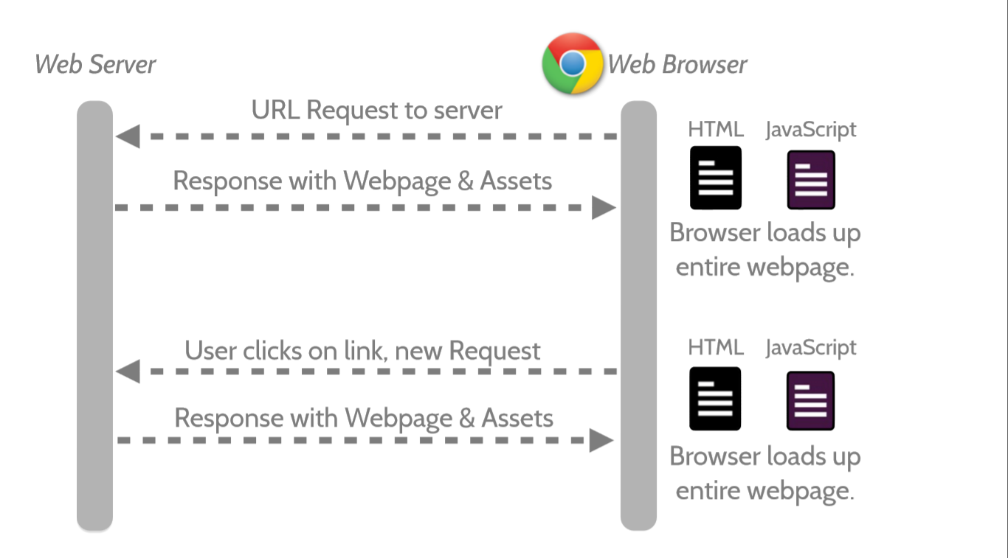
Traditional Page Refresh – Before SPA

Slide 7
Single Page Application (SPA) – What is SPA?
A single-page application (SPA), is a web application that fits on a single web page.
It provides a more fluid user experience akin to a desktop application
Uses client side routing with navigation logic coded on client side
Round trip to the server for every request is avoided, as all view related logic and html templates are present at client side only.
Every hyperlink on home/main page of SPA just loads new html template onto the main page
All libraries on main page are loaded only once at the start.
Less amount of network traffic (data flow to & from Clientside UI-components)

Slide 8
Agenda
History
Single Page Application
Key Challenges Before AngularJS
What is AngularJS
AngularJS Complete Client Side Solution
AngularJS Core Design Principles
AngularJS Core Building Blocks
Simple HelloWorld Example

Slide 9
Key Challenges Before AngularJS
Manipulating Html DOM programmatically - Writing lot of code to fetch data from DOM elements and updating the DOM
Boilerplate code just to get started (e.g. Ajax)
Messy Code resulting from nested call-backs and registering call-backs
No clear cut division of responsibility resulting in tight coupling between:
View and Presentation logic & Model data
Hard coding of component dependencies resulting in tight coupling between:
Presentation logic and Service layer components
Notes:
http://www.agilethought.com/blog/articles/how-to-think-angularjs-in-a-jquery-world
Jquery callback explain -

Slide 10
Agenda
History
Single Page Application
Key Challenges Before AngularJS
What is AngularJS
AngularJS Complete Client Side Solution
AngularJS Core Design Principles
AngularJS Core Building Blocks
Simple HelloWorld Example

Slide 11
What is AngularJS
Open source JS framework by Google & community
AngularJS is one core library
Supports creation of SPA
Gives MV* capability to browser-based single page web application
Good design principles that makes development and testing easier
Can do mind-boggling things in just few lines of code

Slide 12
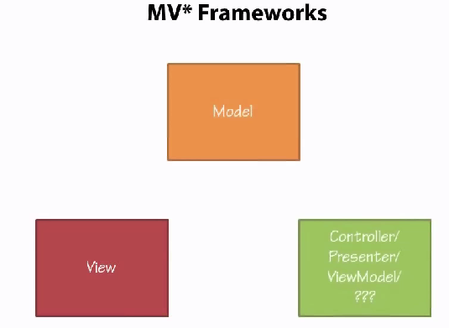
What is AngularJS - MV* Framework

Slide 13
Agenda
History
Single Page Application
Key Challenges Before AngularJS
What is AngularJS
AngularJS Complete Client Side Solution
AngularJS Core Design Principles
AngularJS Core Building Blocks
Simple HelloWorld Example

Slide 14
AngularJS Complete Client Side Solution
Before AngularJS, you would have used
With AngularJS, none of these libraries are needed as Angular provides support for all the above features.
Angular comes with a lightweight version of jQuery called jQLite
Clean and easy to use syntax
Feature | Library
Client-based routing | BackboneJS, Sammy JS
DOM Manipulation | jQuery
Two way binding | KnockoutJS

Slide 15
Agenda
History
Single Page Application
Key Challenges Before AngularJS
What is AngularJS
AngularJS Complete Client side Solution
AngularJS Core Design Principles
AngularJS Core Building Blocks
Simple HelloWorld Example

Slide 16
AngularJS Core Design Principles (1/6)
AngularJs works on following core design principles:
Two way data-binding
Separation Of Concern
Declarative approach – extends Html vocabulary by using directives
Dependency Injection (DI)

Slide 17
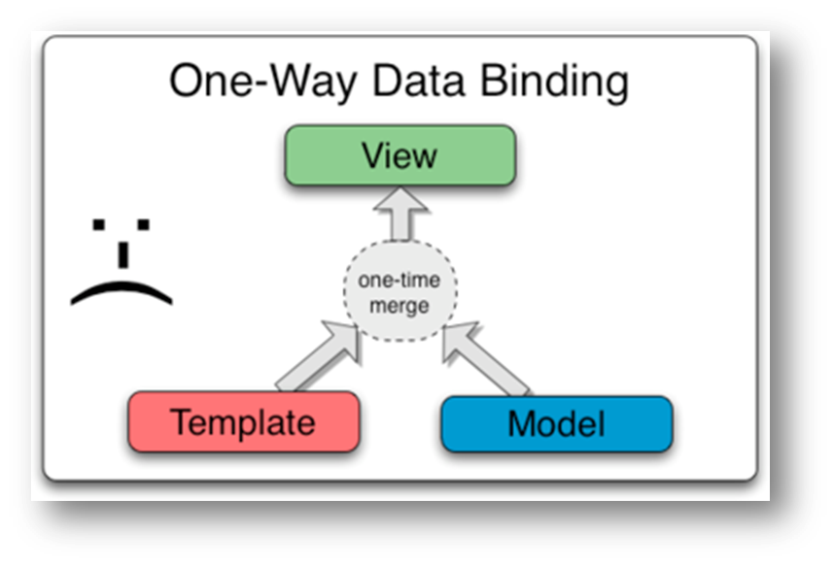
AngularJS Core Design Principles (2/6)
One-way or Classical data binding before AngularJS:
One way data binding merges the template and model components together into a view.
View or Model are not updated automatically when the View or Model is changed
Developer have to write extra code to sync the View and Model

Slide 18
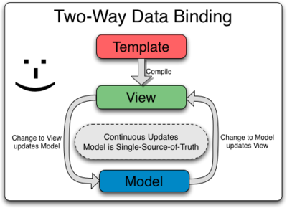
AngularJS Core Design Principles (3/6)
Two-way data binding:
Two way data binding is the core of Angular’s magical spell
View is updated automatically when the Model is changed
Model is updated automatically when the value in the view has changed

Slide 19
AngularJs Core Design Principle (4/6)
Separation Of Concerns:
Software systems must be decomposed into parts such as modules as much as possible.
In AngularJS, the code can be broken down into components like controllers, views, models, and services.
One doesn’t need to write much code for DOM manipulation
AngularJS makes the code more clearer
Client side
Client Side
controller
Server side
Controller Function
View
Model and presentation logic
Web service
Angular ajax call
Service
Notes:
http://victorblog.com/2013/03/18/angularjs-separation-of-concerns/
There is decoupling between view and controller as well as controller and service. Thus we are achieving goal of separation of concern.

Slide 20
AngularJs Core Design Principle (5/6)
Declarative Approach – extends Html vocabulary by using directives:
Declarative approach directs Angular what should be done on our behalf instead of we explicitly coding for it.
We use Angular directives to tell Angular what has to be done
Directives are used as attributes of html element inside html page
<div id=“myid” ng-controller=“DemoController”></div>
ng-controller – is angular directive that tells angualr to instantiate the Controller function and inject dependencies to it.
<body ng-app>
ng-app – This directive auto-bootstraps angularjs application at body element
Directives handle everything automatically in the background, we need not code anything explicitly to get it done
Notes:
https://docs.angularjs.org/api/ng/directive/ngApp

Slide 21
AngularJs Core Design Principle (6/6)
Dependency Injection:
DI - object is given its dependencies, rather than the object creating them itself.
Avoids tight coupling with dependency creation logic by creating dependencies outside the application
Dependency is instantiated and injected by Angular when dependency name is mentioned as function argument inside controller or service function.
// ’calcService’ is dependency
module.controllerFunction(calcService) {
// once injected we can use it normal way invoking functions on it
calcService.add(3,5);
… }
It is possible to change dependency without breaking code that uses that dependency.
Allows injecting mock objects as dependencies in absence of actual dependency making unit testing easy
Angular has two important services which makes DI possible - $injector and $provide which we will see later.
Notes:
https://docs.angularjs.org/api/auto/service/$provide
https://docs.angularjs.org/api/auto/service/$injector

Slide 22
Agenda
History
Single Page Application
Key Challenges Before AngularJS
What is AngularJS
AngularJS Complete Client Side Solution
AngularJS Core Design Principles
AngularJS Core Building Blocks
Simple HelloWorld Example

Slide 23
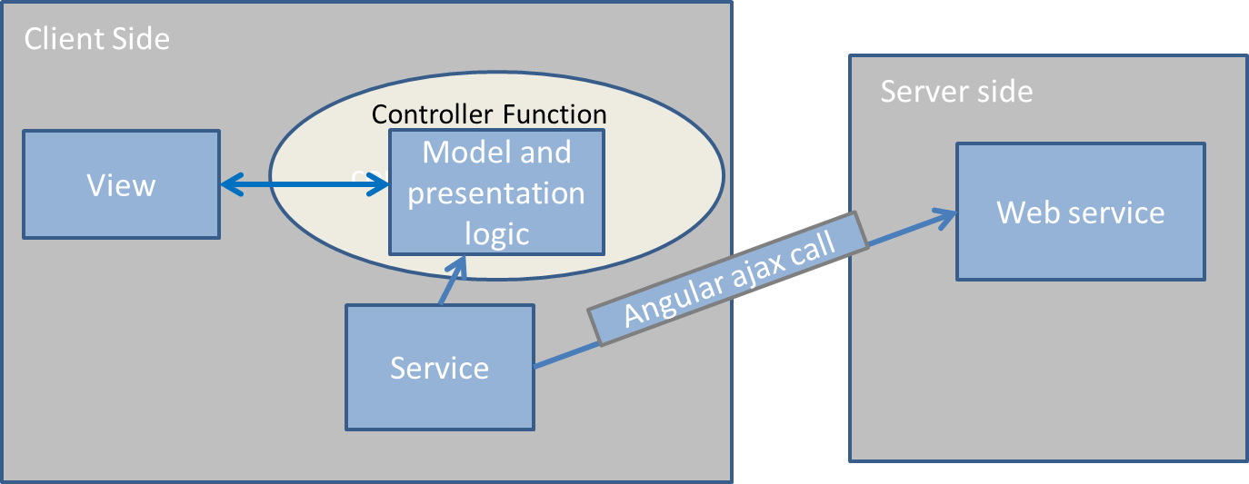
AngularJS Core Building Blocks
Model
View
Controller
Services
Modules

Slide 24
Agenda
History
Single Page Application
Key Challenges Before AngularJS
What is AngularJS
AngularJS Complete Client Side Solution
AngularJS Core Design Principles
AngularJS Core Building Blocks
Simple HelloWorld Example

Slide 25
Simple HelloWorld Example
ng-app
Declarative way – function calls not needed like JQuery
Directives
ng-model
ng-init, ng-repeat
AngularJS API… Eg - ng-app: https://docs.angularjs.org/api/ng/directive/ngApp
ng-show, ng-hide
Filters, filter chaining & Sorting
uppercase, lowercase, orderBy, filter

Slide 26







CitiusTech
Offerings
Software Engineering Success Stories
Professional Services Success Stories
Thank You
BI-Clinical
Success Stories
www.citiustech.com

